Slide 1


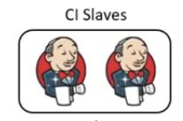





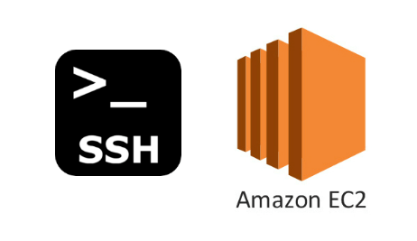
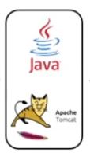

Code Quality Failure, Trigger alerts and abort the build
Code Quality Check
Check In
Maven Build and Package
Webhook
Code Quality passed
Archive to java binary files
Machine Provision
Trigger Ansible Playbook
Fetch Latest version of Archive file
Package
Code Deployment
Installation

